Slide 1
Switch Case
Er.Sudan Prajapati

Slide 2
A switch statement allows a variable to be tested for equality against a list of values.
Each value is called a case, and the variable being switched on is checked for each switch case.
Syntax:
switch(expression){
case constant-expression :
statement(s);
break; /* optional */
case constant-expression :
statement(s);
break; /* optional */
/* you can have any number of case statements */
default : /* Optional */
statement(s);
}

Slide 3
Rules of switch
The expression used in a switch statement must have an integral or enumerated type, or be of a class type in which the class has a single conversion function to an integral or enumerated type.
You can have any number of case statements within a switch. Each case is followed by the value to be compared to and a colon.
The constant-expression for a case must be the same data type as the variable in the switch, and it must be a constant or a literal.
When the variable being switched on is equal to a case, the statements following that case will execute until a break statement is reached.
When a break statement is reached, the switch terminates, and the flow of control jumps to the next line following the switch statement.
Not every case needs to contain a break. If no break appears, the flow of control will fall thought o subsequent cases until a break is reached.
A switch statement can have an optional default case, which must appear at the end of the switch. The default case can be used for performing a task when none of the cases is true. Nobreak is needed in the default case.

Slide 4
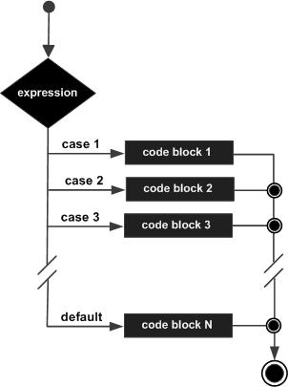
Flow chart

